Slide 1
GRE Admission Prediction
Done By:
Yuvaraj Tankala (AP19110010221)
Subrahmanyam Konakanchi (AP19110010192)

Slide 2
Introduction
The application process for many universities consists of assessing the student's aptitude, academic record and evaluating tests like GRE, TOEFL and IELTS. Students applying to these universities are judged based on these factors.

Slide 3
Project Details
"University Admission Prediction based on GRE scores ". This project uses a dataset consisting of GRE scores, Toefl scores, SOPs, LOPs, CGPAs, and probability to attain admission at particular universities.
We tested several machine learning algorithms and found three (KNN, Random Forest,Logistic Regression) that were more than 80% accurate in predicting the data.

Slide 4
Machine learning algorithms Used
KNN Classifiers
Random Forest Classifier
Logistic Regression

Slide 5
Tech Stack
Python packages (Scikit learn,Torch,Matplot,Pandas,Numpy)
Django
HTML,CSS

Slide 6
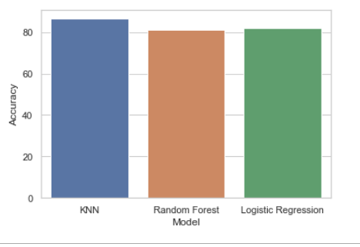
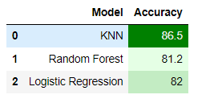
Results & Output

Slide 7
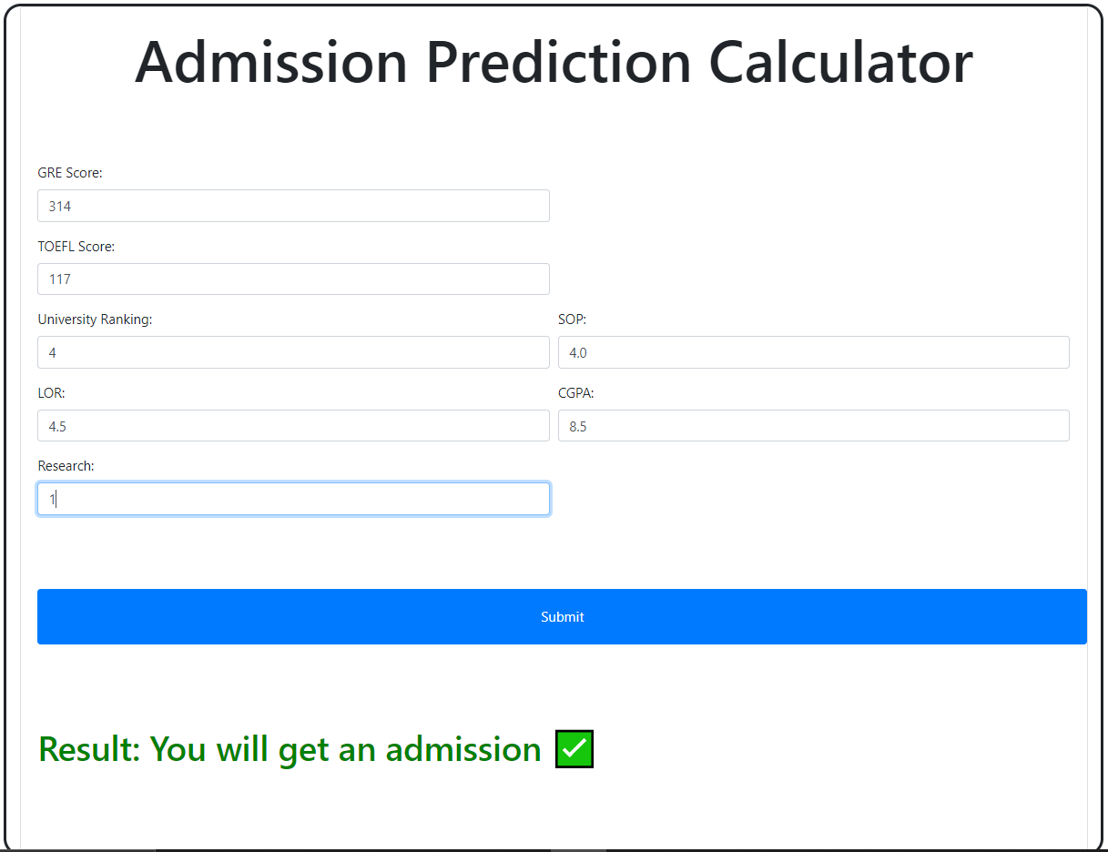
Results & Output

Slide 8
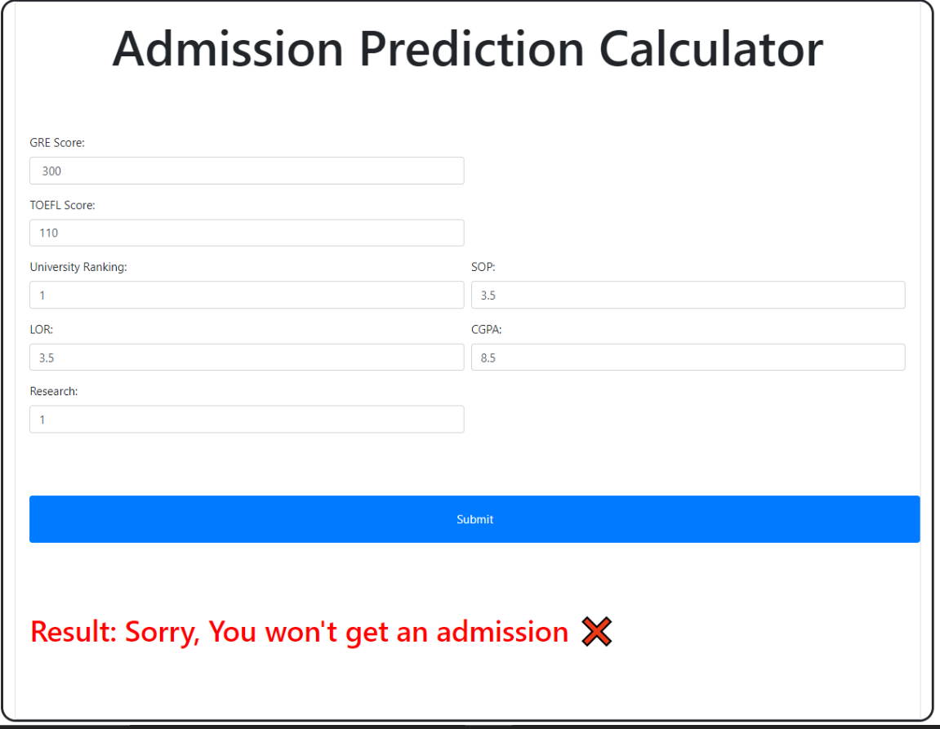
Results & Output

